Slide 1
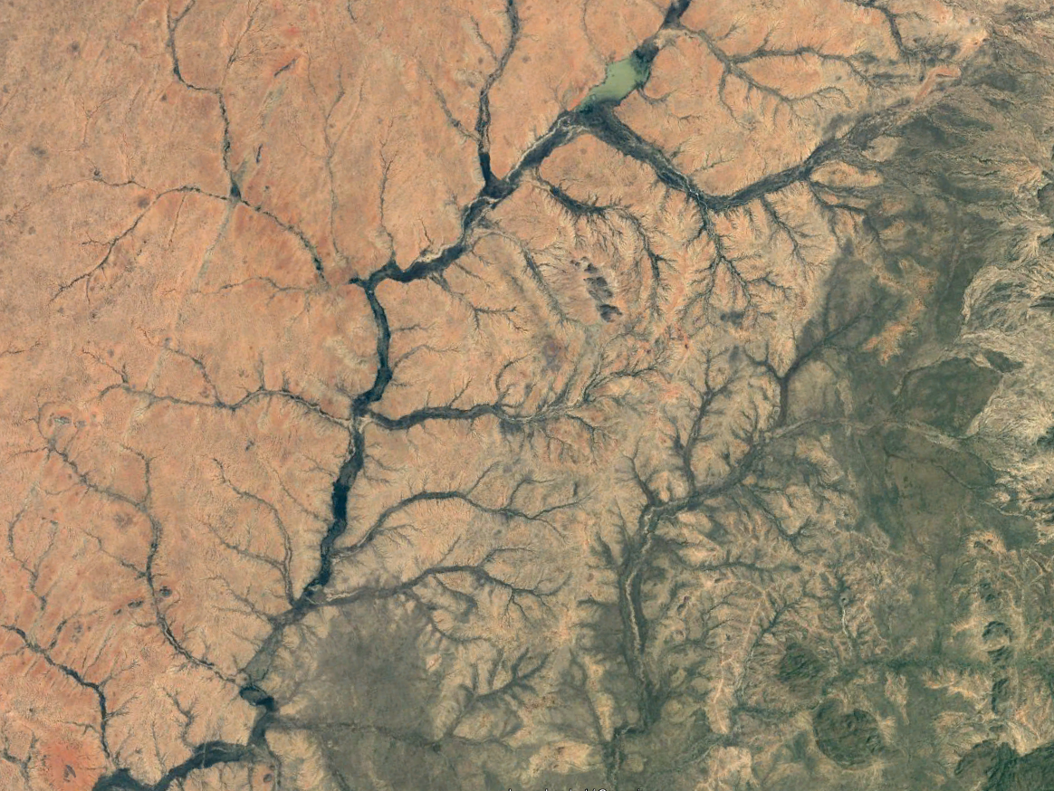
Continental Clastic Environments
EART23202, Ian Kane.

Slide 2
Range of clastic environments
Rivers – fluvial, alluvial
Lakes - Lacustrine
Glacial - moraine, outwash
Desert – aeolian
Volcanic – pyroclastics, debris flows
Soils
Natural, urban, and inbetween

Slide 3
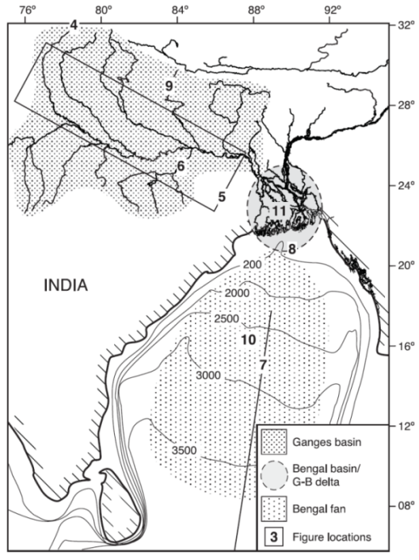
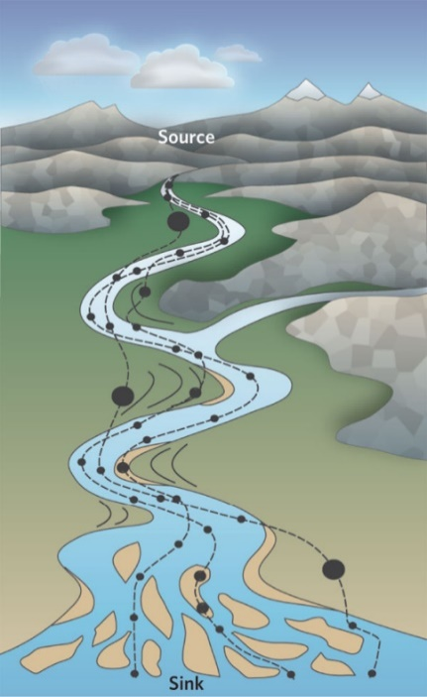
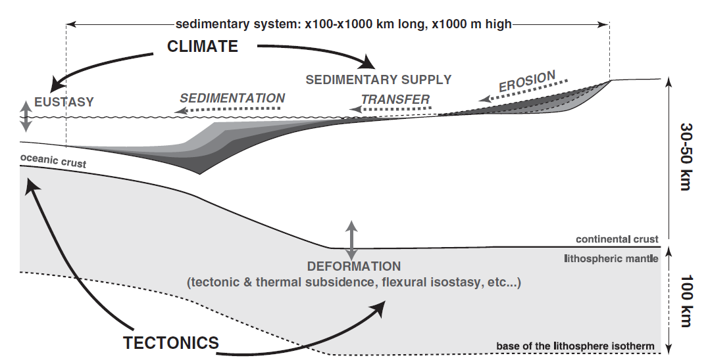
Source-to-sink
Meade (1972) was among the first to apply the source-to-sink terminology when investigating suspended sediment dispersal along the eastern US margin
Has later been used to:
study seasonal flux from near-shore to shelf
study 10-100 my denudation and basin filling along continental margins
investigating processes, signal transfer, response to perturbations, sediment budget, provenance
Goodbred, 2003
Allen, 2008
Guillocheau et al., 2011

Slide 4
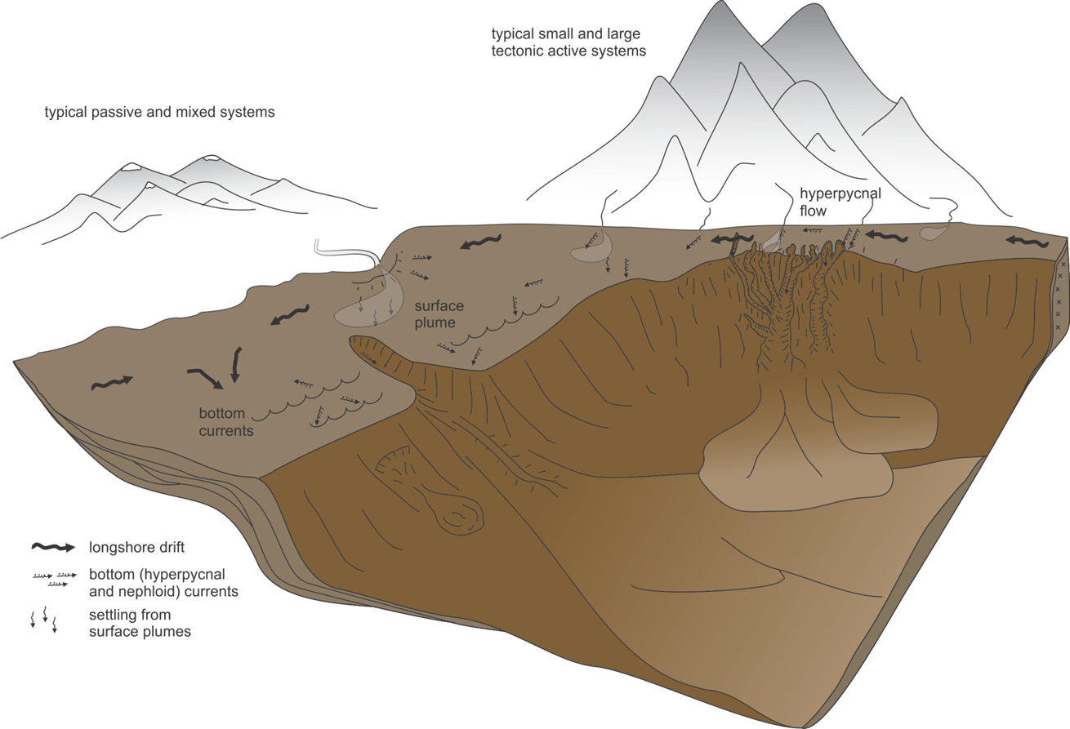
The Source-to-Sink system

Slide 5
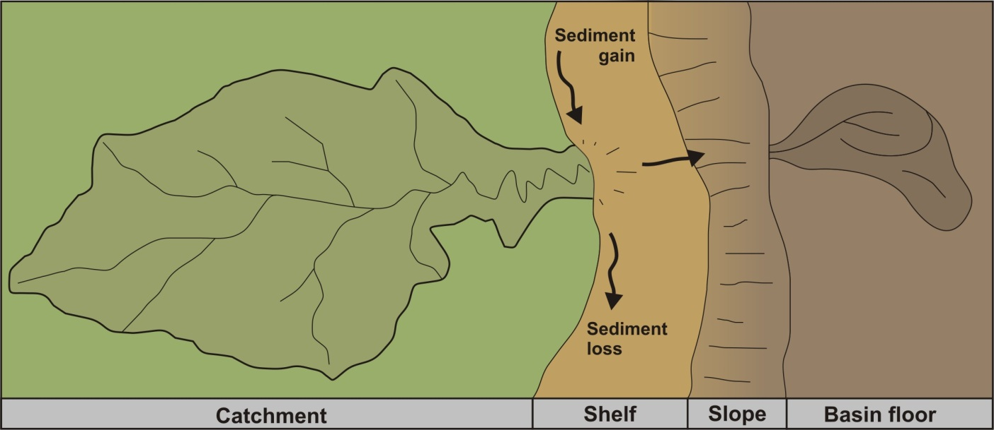
What is source to sink
What it involves
Why it is useful
The complete sediment routing system
A holistic approach
Integration of multiple data sources
Focus on link between segments/ depositional environments
Link between processes and stratigraphy
Improve understanding of landscape and seascape evolution in 3D
Encourage thinking across disciplines
Improve predictability in ancient systems

Slide 6
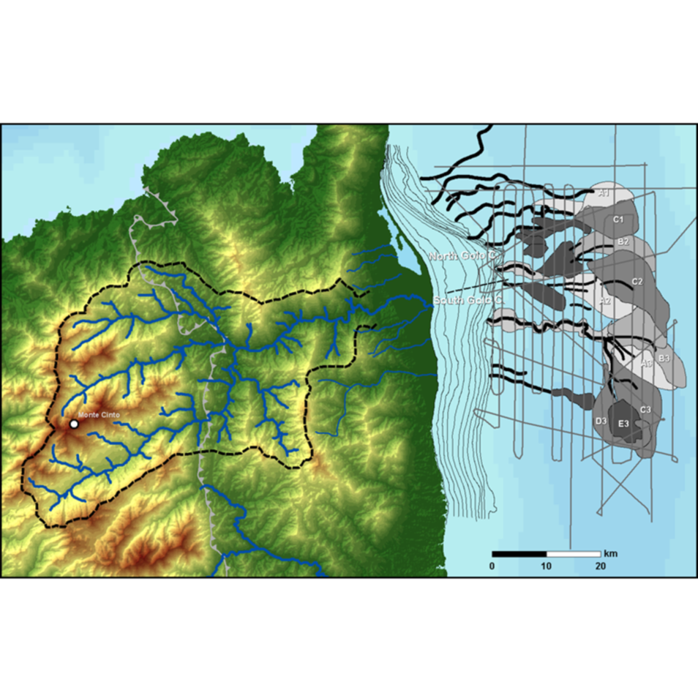

Slide 7
Focus on Fluvial systems
Why important:
  Deliver vast majority of terrestrial sediment, organic carbon, and pollutants to the coast.
  Provide water
  Flooding
  Power generation
  Fishing
  Etc

Slide 8
Definitions:
River: a ‘large’ conduit for the flow of water and sediment
Fluvial: processes and bedforms relating to rivers
Alluvial: processes and deposits related to rivers but occuring outside of the channel itself (floodplains, deltas)

Slide 9
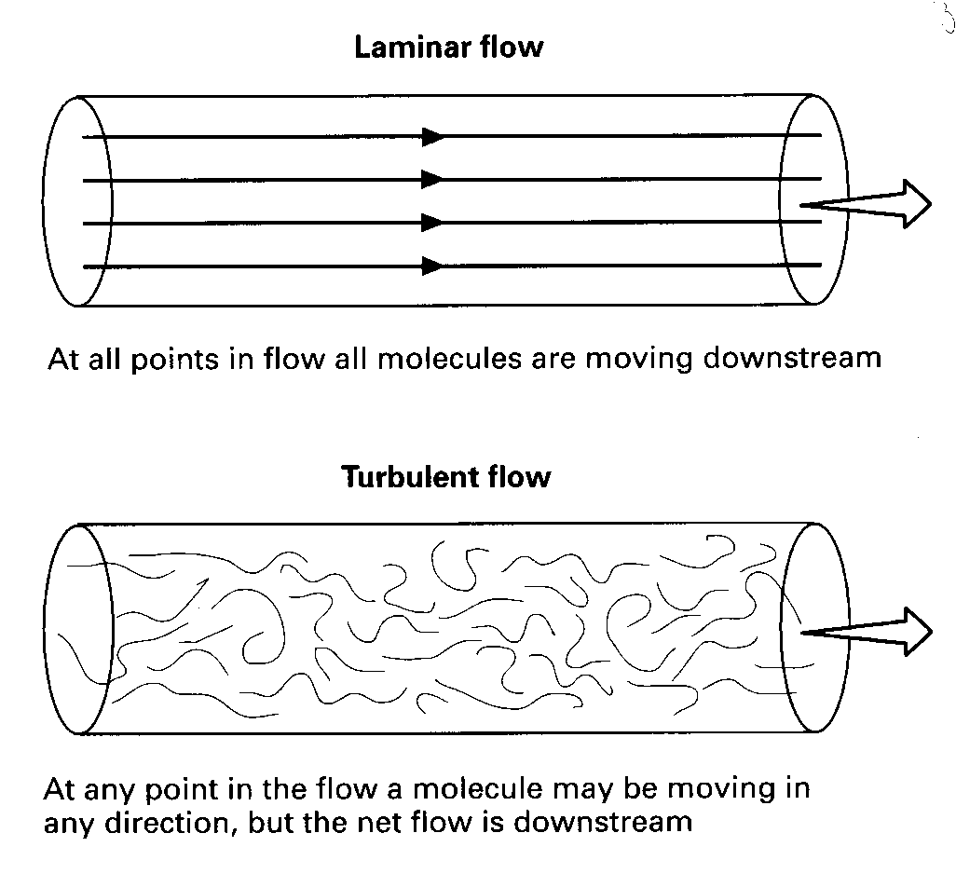
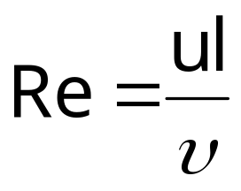
Reynolds number (laminar vs. turbulent flow)
u=flow velocity; l=characteristic length (flow depth); υ=kinematic
viscosity (dynamic viscosity/fluid density)
(water ~ 1.5x10⁻⁶ m²/s)
Turbulence is promoted by high flow velocities and flow depths, and low viscosities (Re>2000); laminar flow occurs at Re<500
Air and water are nearly always turbulent

Slide 10
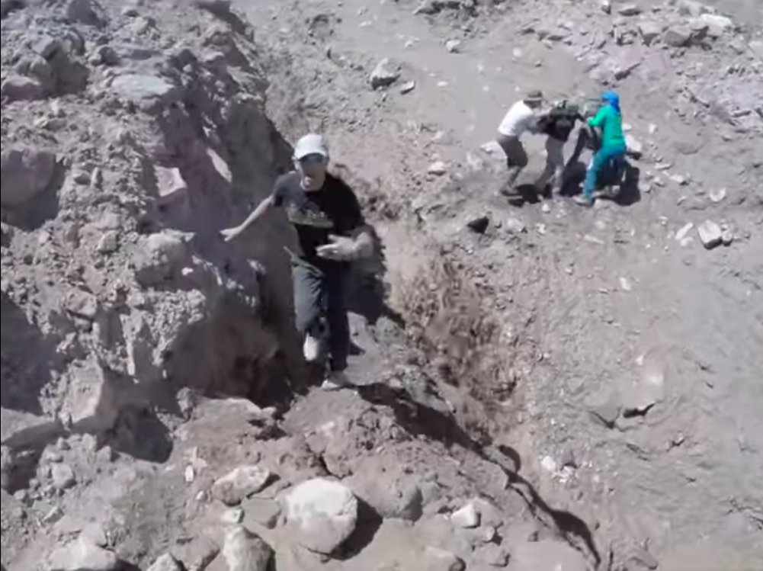
Click me!

Slide 11
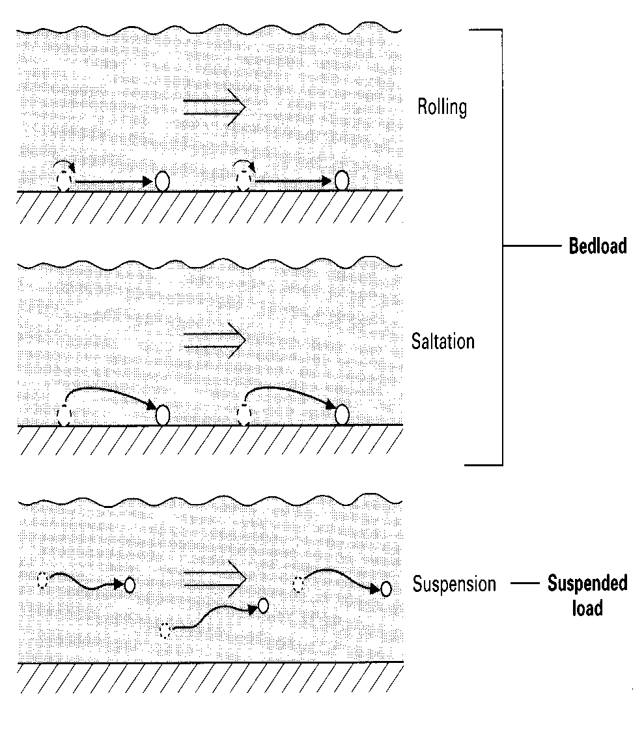
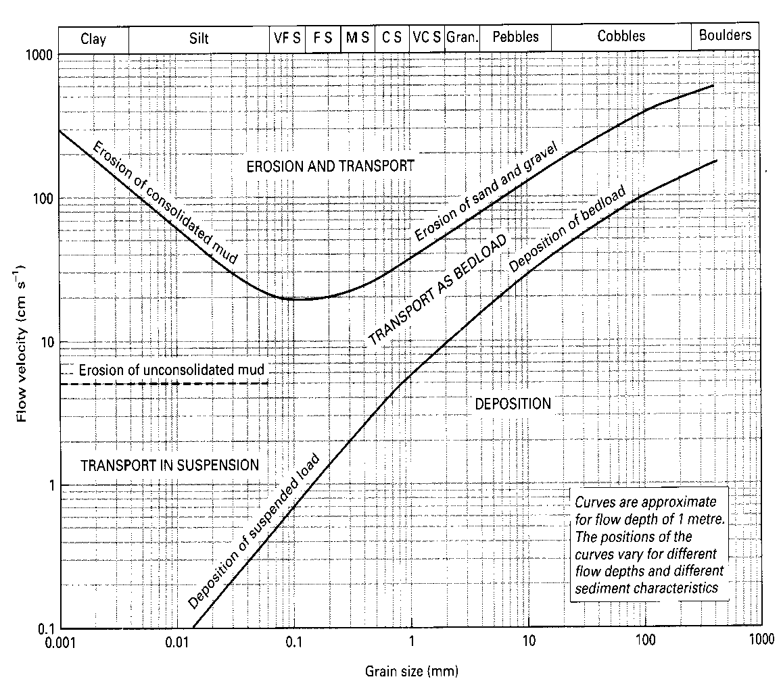
Sediment transport in a river
Notes:
The Hjulström curve, named after Filip Hjulström, is a graph used by hydrologists and geologists to determine whether a river will erode, transport, or deposit sediment. It was originally published in his doctoral thesis "Studies of the morphological activity of rivers as illustrated by the River Fyris." in 1935

Slide 12
Rivers: Sediment transport
Three modes:
    Dissolved load/wash load (ions in solution - pollution)
    Suspended load
      Fine particles (sand, silt & clay)
      Turbulent eddies pick up, carry upward if vel. > settling vel.
    Bedload
      On/near bed; rolling, bouncing (‘saltating’), etc.
Suspended and bedload transport increase rapidly with flow strength (nonlinear relationship)

Slide 13
Rivers: Two main kinds
Alluvial rivers; bed consists of sediment (‘alluvium’ = river-associated sediment)
  Downstream reaches
Bedrock rivers; part of the bed is bare rock, which the river has eroded into cutting down
  generally in upper reaches of rivers

Slide 14
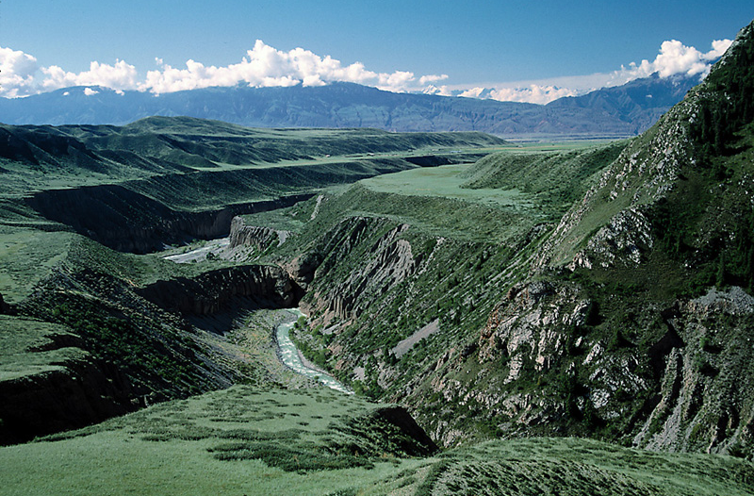
Bedrock incised to alluvial incised

Slide 15
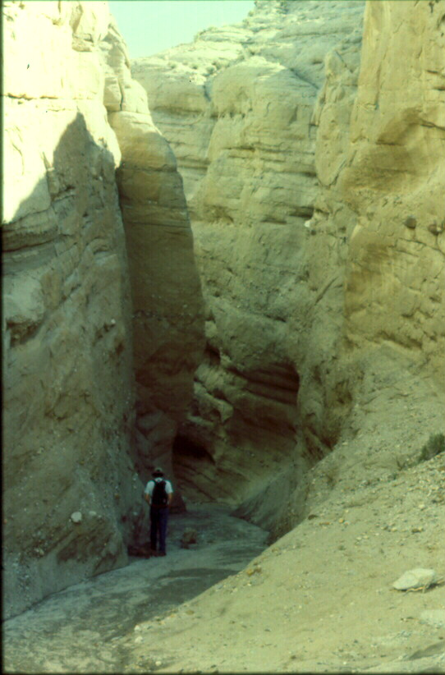
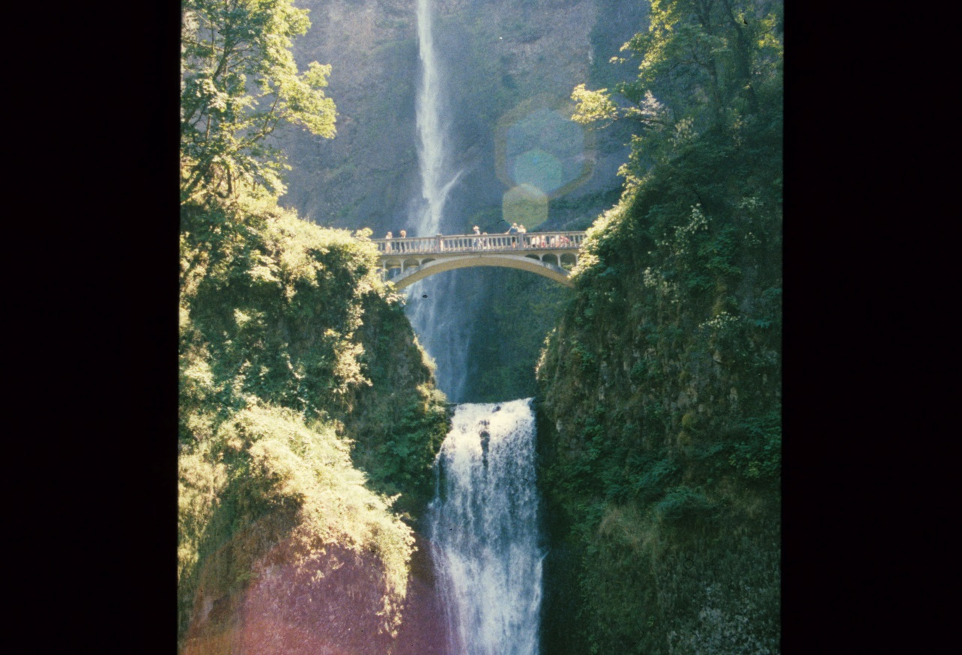
Bedrock Rivers
Erosion rate depends on slope
Presence of sediment (‘tools’) increases erosion

Slide 16
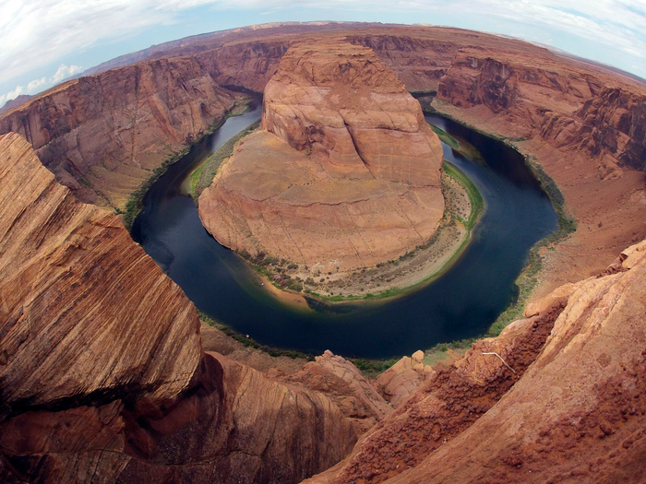
Colorado River, Horseshoe Bend
Notes:
Photo: Charles Platiau/Reuters

Slide 17
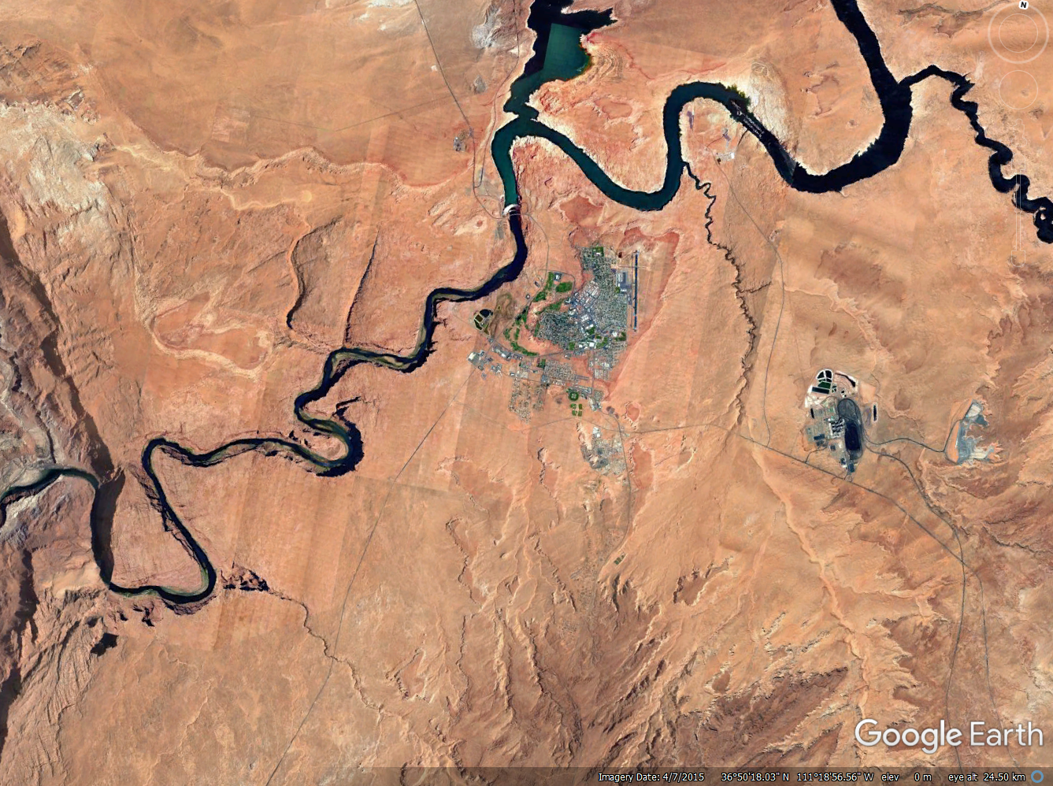
Colorado River

Slide 18
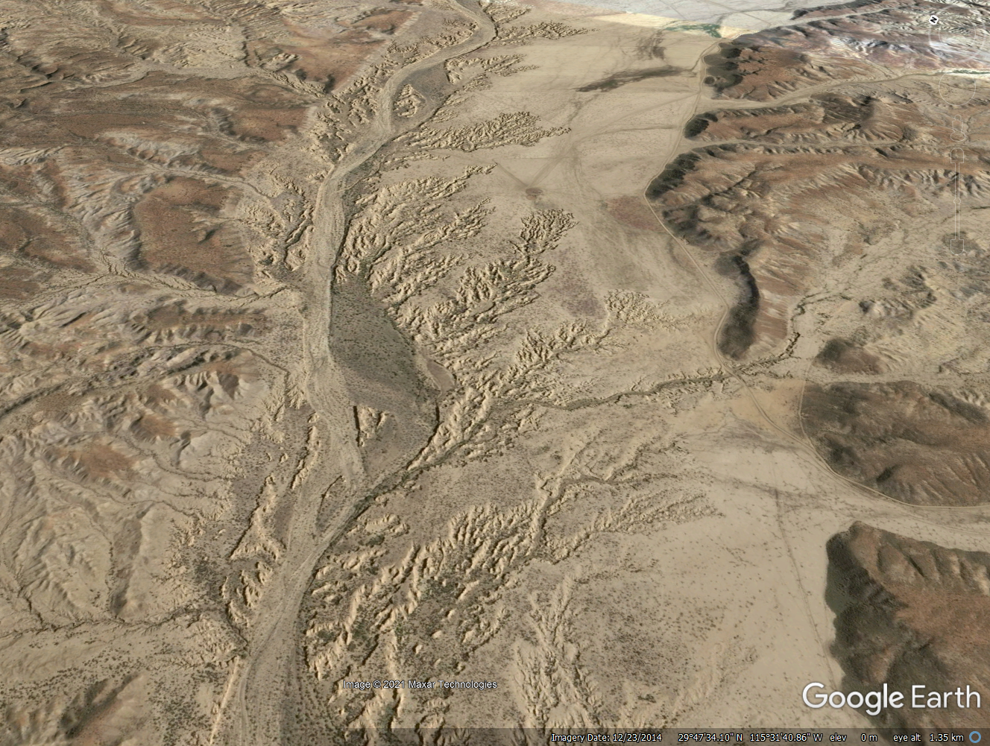
Alluvial Rivers
Arroyo San Fernando (Mexico)
Notes:
Location: 29°43'6.46"N 115°38'52.68"W

Slide 19
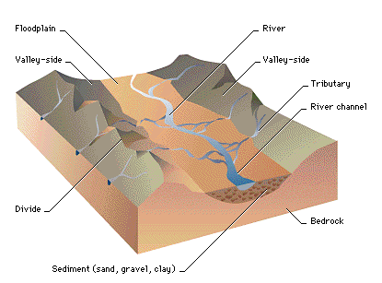
Landform: Floodplain

Slide 20
Alluvial Rivers
River
Bedrock
Bedrock
Tributary
Floodplain
Notes:
Location: 29°43'6.46"N 115°38'52.68"W

Slide 21
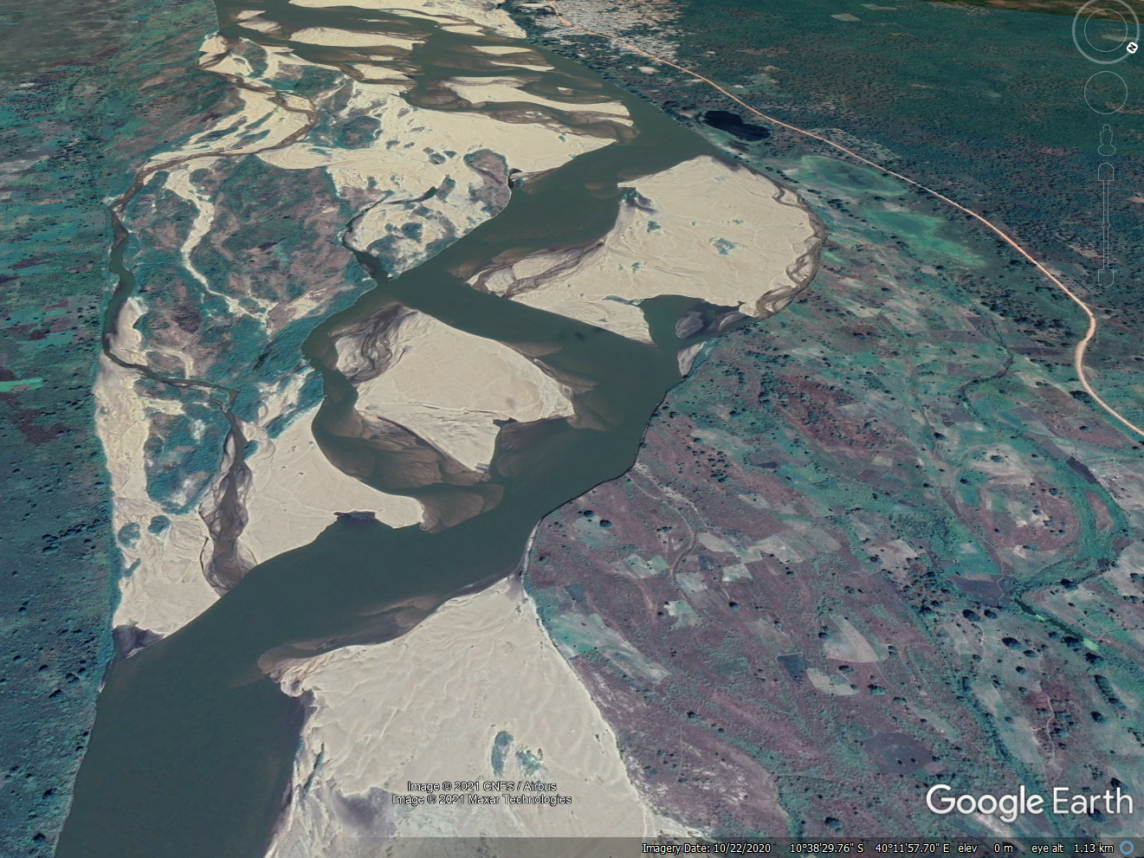
Braided Rivers
Rovuma River (Mozambique)

Slide 22
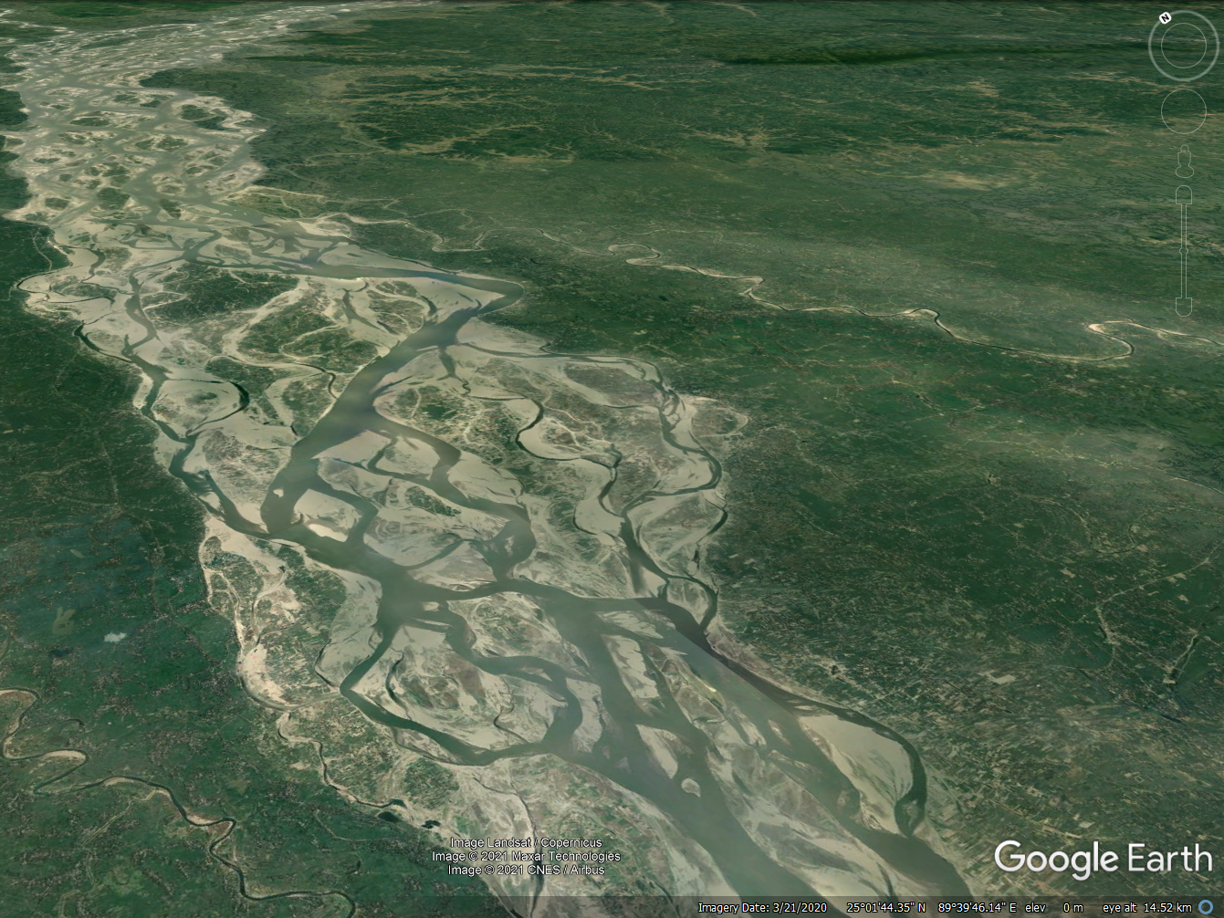

Slide 23
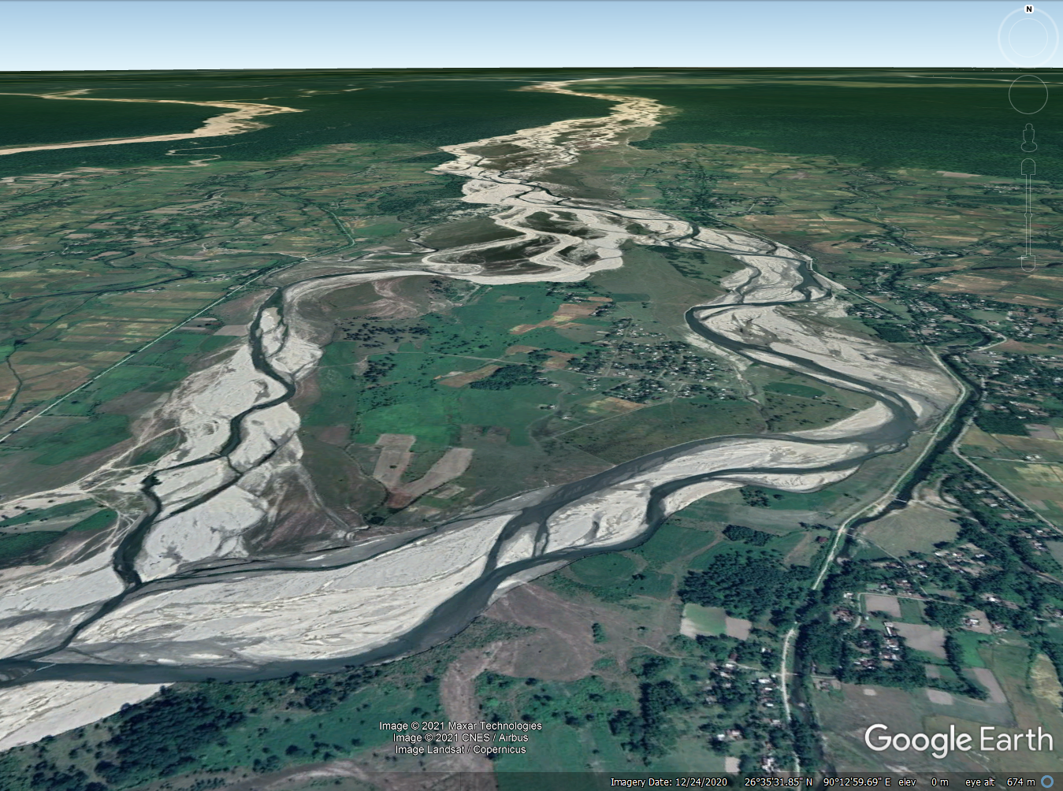
Notes:
26°35'31.85"N 90°12'59.69"E

Slide 24
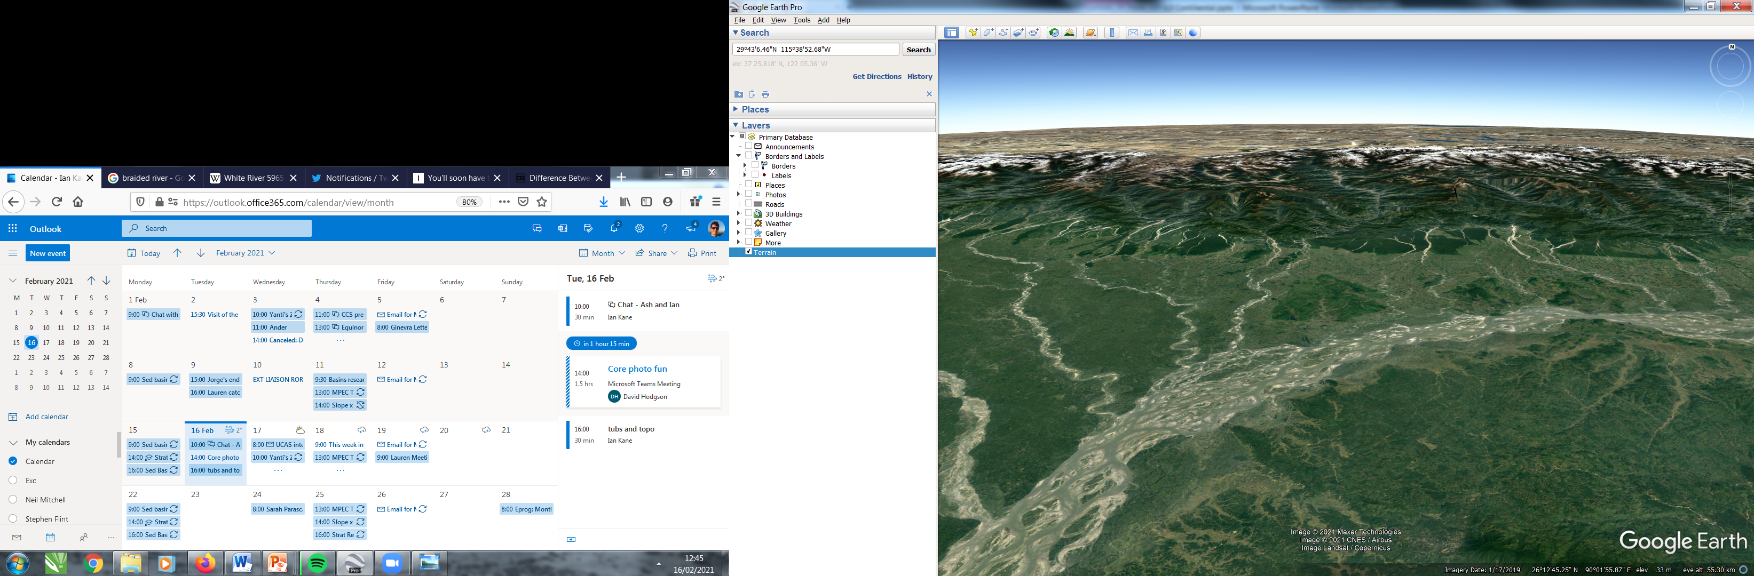

Slide 25
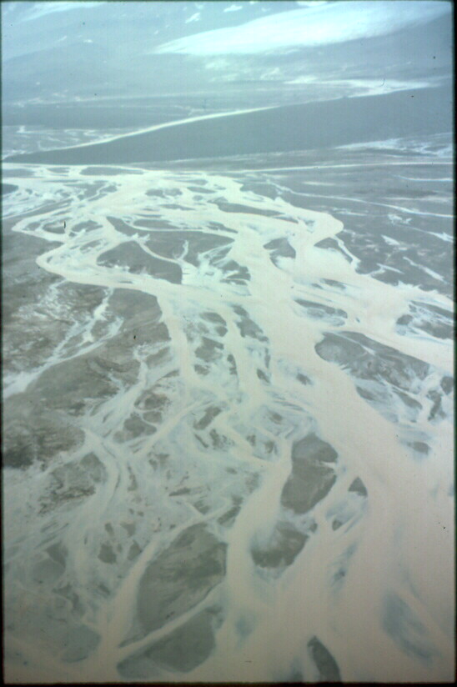
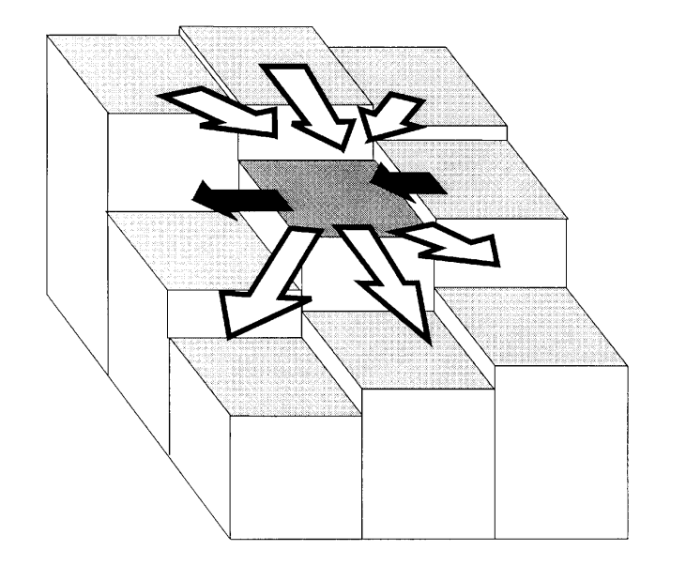
Braided streams are bedload dominated
Nonlinear sediment transport laws result in dynamic feedbacks

Slide 26
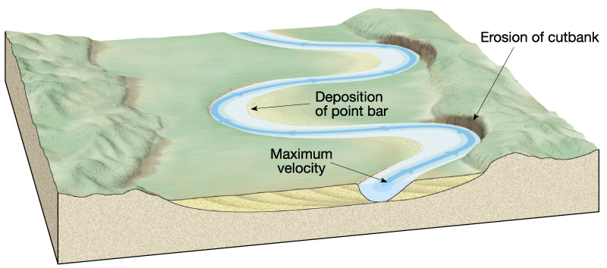
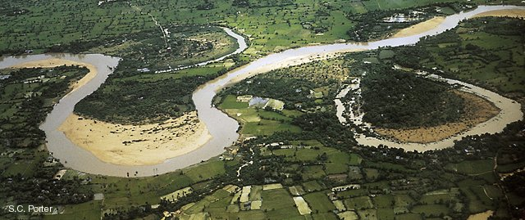
Meandering stream; Point Bar and Cut Bank

Slide 27
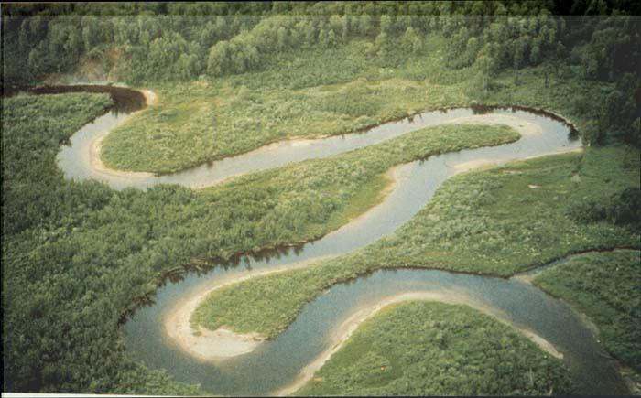
Point Bars and Cutbanks
Santee River, SC
Photo by Duncan Heron

Slide 28
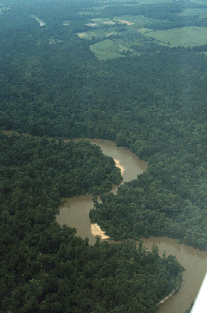
Neuse River, NC
Note point bars
Photo by Duncan Heron

Slide 29
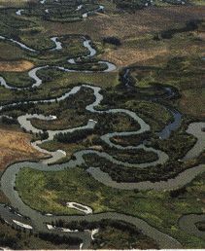
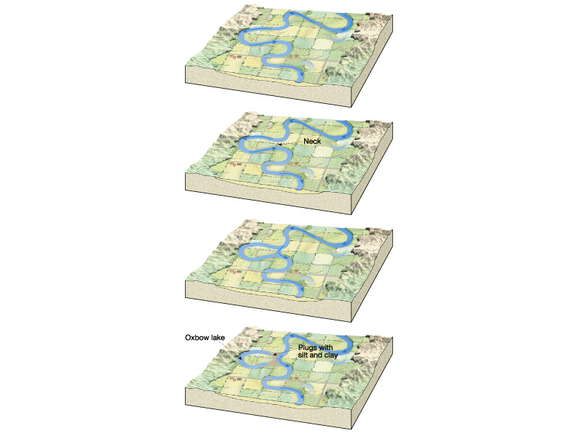
Oxbow lake formation

Slide 30
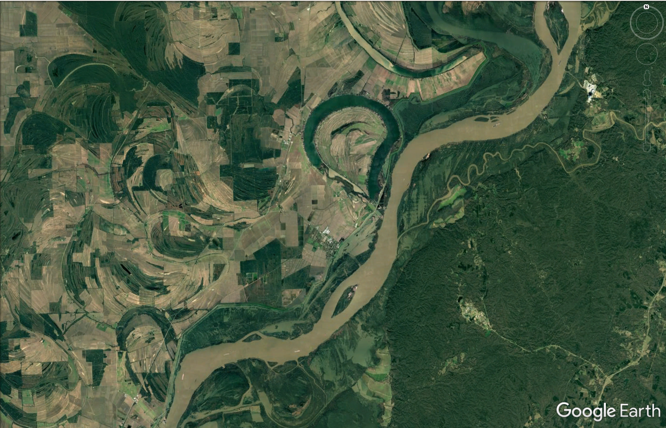

Slide 31
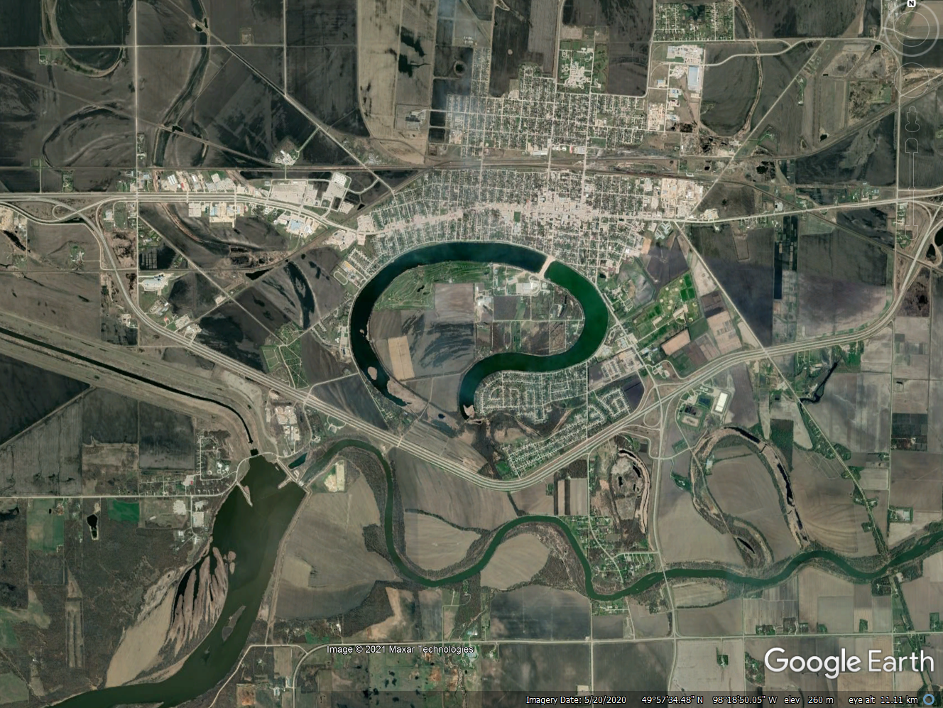
Portage la Pairie, Canada
Notes:
Portage la Pairie

Slide 32
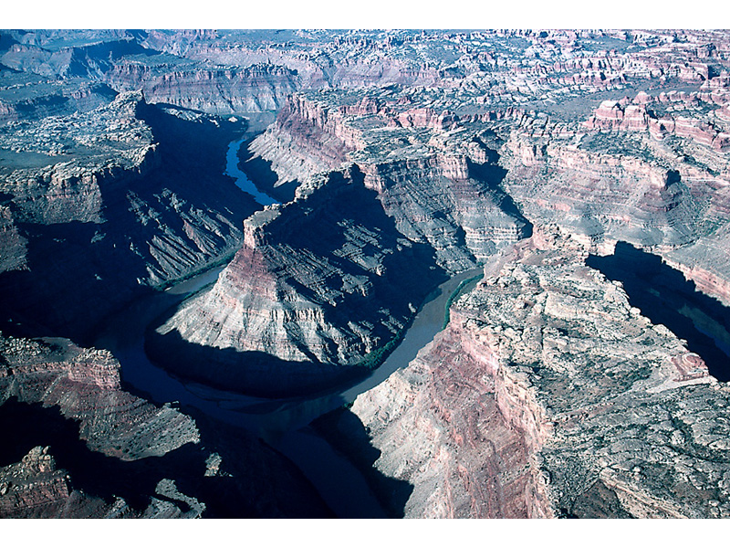
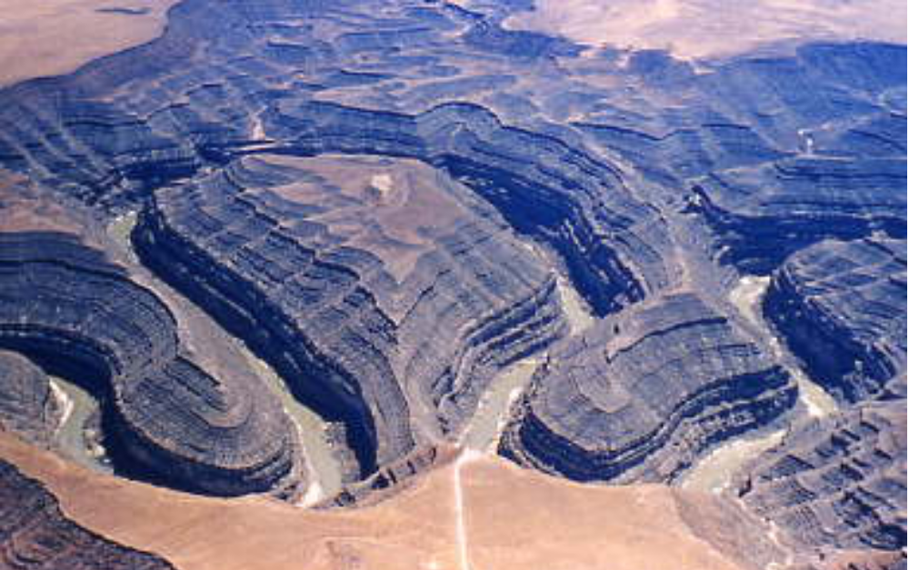
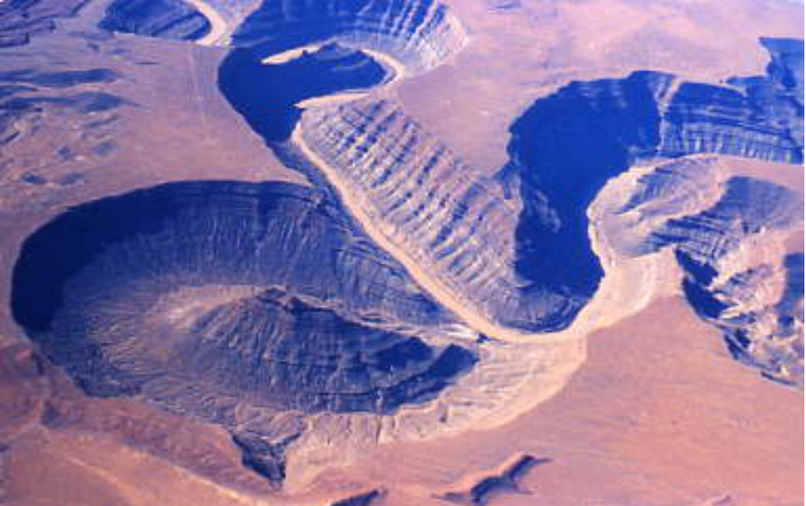
Incised Meanders

Slide 33
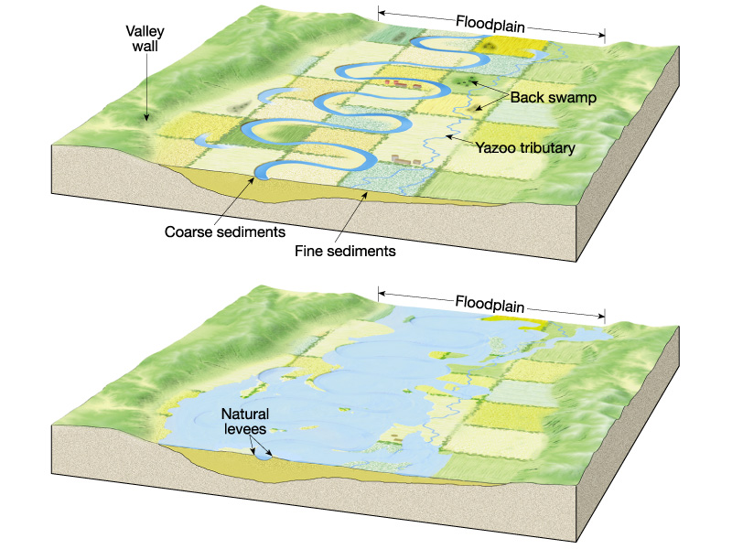
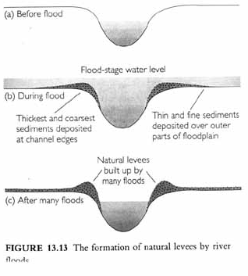
Natural Levee formation

Slide 34
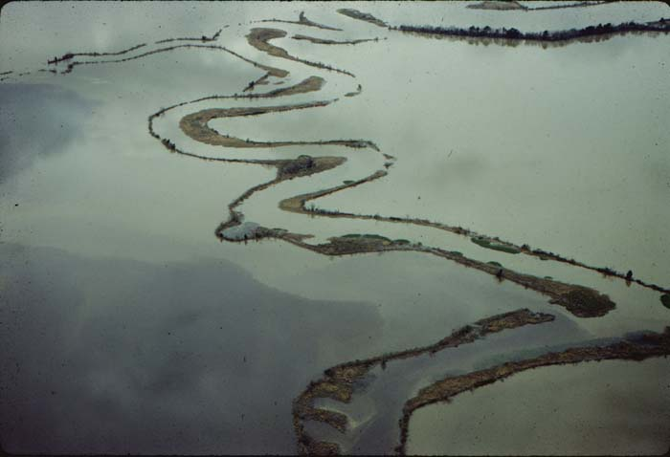
Photo by Duncan Heron

Slide 35
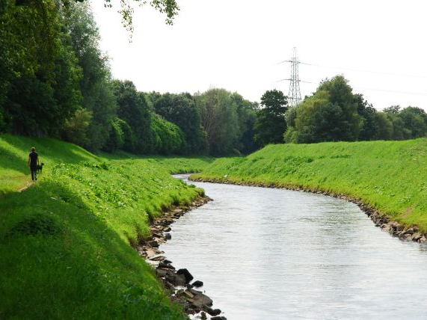
River Mersey

Slide 36
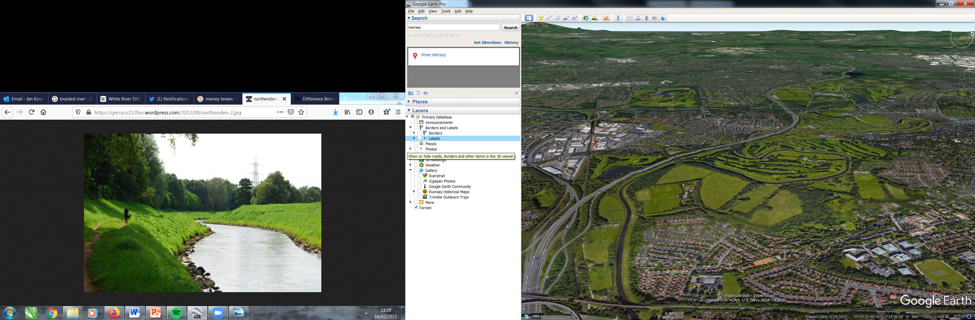

Slide 37
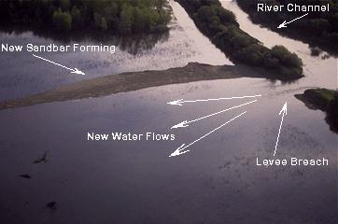
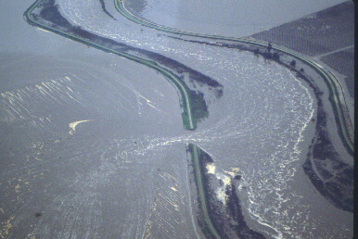
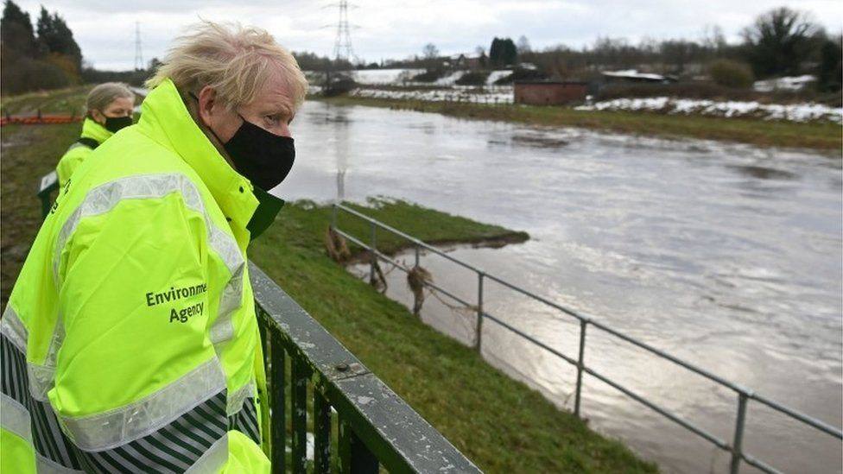
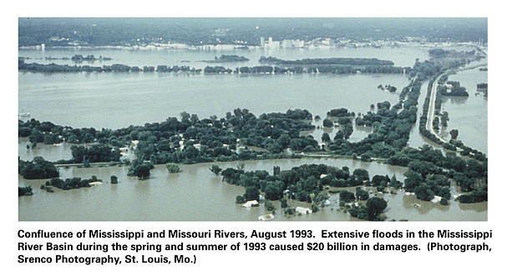
Levee Failures

Slide 38
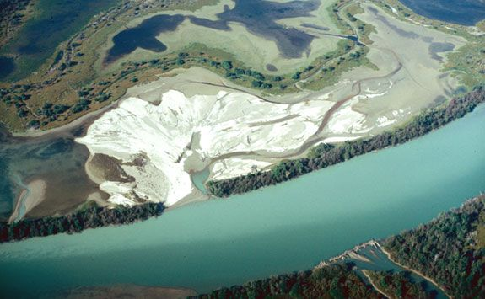
Crevasse Splay Deposits, Mississippi River

Slide 39
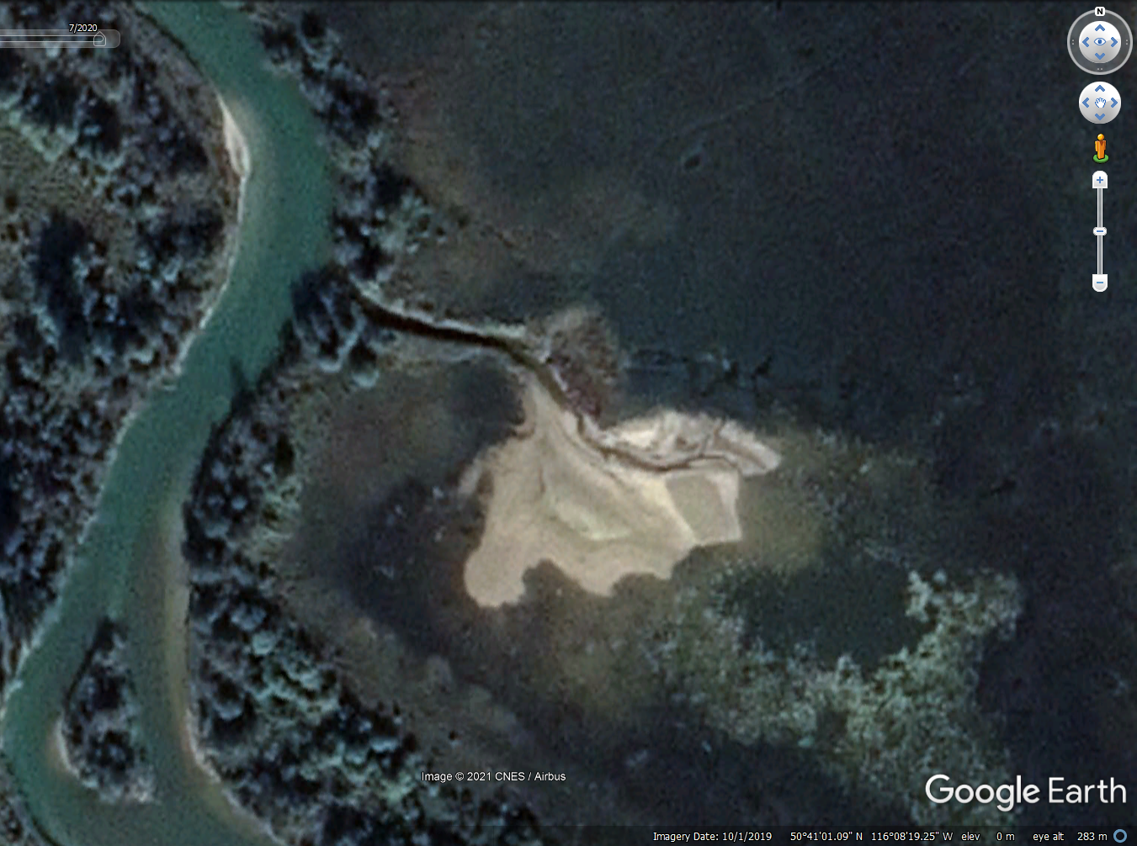
Columbia River, Canada

Slide 40
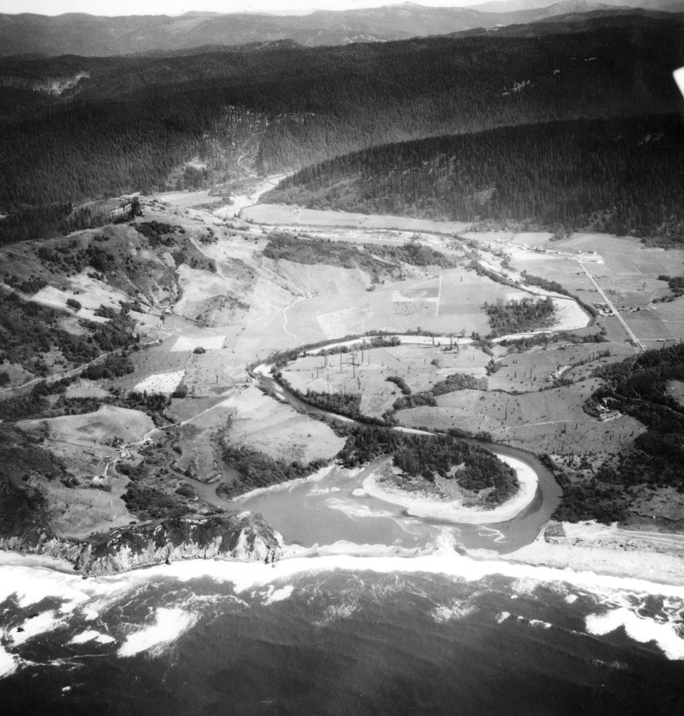
Natural River - 1948

Slide 41
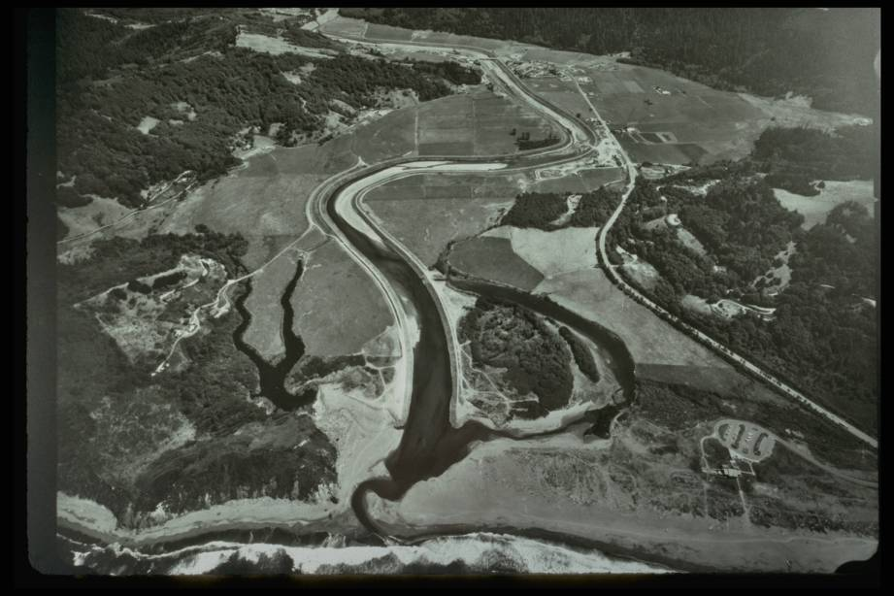
1964

Slide 42
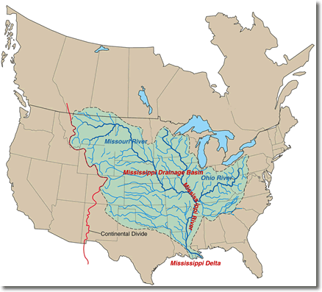

Drainage Basins

Slide 43


Graded Stream Profile
Flow increases downstream (tributaries)
Velocity Increases
Equilibrium slope reduces as flow increases

Slide 44
Graded Stream Profile
Each stretch of alluvial river tends to have slope adjusted to transport sediment delivered to it
    Slope too low, sediment piles up at upstream end
    -> slope increases
    Slope too high, erosion (less in than out) at upstream end
    -> slope decreases
Need steeper slope with
    Less flow
    Larger grains

Slide 45


Base Level Changes

Slide 46
Summary

